Slide 1



LECTURE 8:
ATTENTION AND TRANSFORMER
University of Washington, Seattle
Fall 2024

Slide 2
Previously in EEP 596…
x^{G}
x
Output samples x^{G}
Input sample x
Neural Network
(G)
GAN
Neural Network
(D)
z
0/1
Random noise

Slide 3
OUTLINE
Part 1: Transformer motivation
Limitation of RNNs with sequence data
Seq2seq and attention
Attention is all you need
Part 2: Self-attention layer
Overview
Key, Query and Value retrieval process
Multi-headed attention
Part 3: Transformer architecture
Encoder
Decoder
Transformer vs RNN
Part 4: Transformer applications
NLP
Computer vision
Multi-modal
Signal processing

Slide 4
Transformer Motivation Limitations of RNNs with sequence data Seq2Seq and attention Attention is all you need

Slide 5
Limitations of RNNs
output
안녕하세요
제
이름
은
지민이에요
hidden
input
Hello
my
name
is
Jimin
Notes:
In this course, we will be using PyTorch as our main deep learning framework

Slide 6



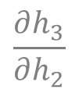




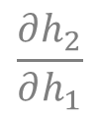






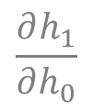



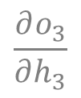
Vanishing and Exploding Gradients
Forward
Backward
output
$$o_{0}$$
$$o_{1}$$
$$o_{2}$$
$$o_{3}$$
$$o_{4}$$
$$\frac{∂h_{1}}{∂h_{0}}$$
$$\frac{∂h_{2}}{∂h_{1}}$$
$$\frac{∂h_{3}}{∂h_{2}}$$
$$\frac{∂o_{3}}{∂h_{3}}$$
…
hidden
$$h_{0}$$
$$h_{1}$$
$$h_{2}$$
$$h_{3}$$
$$h_{4}$$
input
$$x_{0}$$
$$x_{1}$$
$$x_{2}$$
$$x_{3}$$
$$x_{4}$$
Longer input sequence $→$
higher risk of Vanishing/Exploding Gradients!
Notes:
In this course, we will be using PyTorch as our main deep learning framework

Slide 7
RNN Architecture
output
안녕하세요
hidden
input
Hello
Notes:
In this course, we will be using PyTorch as our main deep learning framework

Slide 8
RNN Architecture
output
안녕하세요
제
hidden
input
Hello
my
Notes:
In this course, we will be using PyTorch as our main deep learning framework

Slide 9
RNN Architecture
output
안녕하세요
제
이름
hidden
input
Hello
my
name
Notes:
In this course, we will be using PyTorch as our main deep learning framework

Slide 10
RNN Architecture
output
안녕하세요
제
이름
은
hidden
input
Hello
my
name
is
Notes:
In this course, we will be using PyTorch as our main deep learning framework

Slide 11
RNN Architecture
output
안녕하세요
제
이름
은
지민이에요
hidden
input
Hello
my
name
is
Jimin
Notes:
In this course, we will be using PyTorch as our main deep learning framework

Slide 12

RNN Architecture
output
안녕하세요
제
이름
은
지민이에요
hidden
input
Hello
my
name
is
Jimin
Each input (token) is fed sequentially $→$
No parallelization
Notes:
In this course, we will be using PyTorch as our main deep learning framework

Slide 13
RNN Architecture
output
안녕하세요
제
이름
은
지민이에요
hidden
input
Hello
my
name
is
Jimin
Difficult to store long-term context when sequence is long
Notes:
In this course, we will be using PyTorch as our main deep learning framework

Slide 14
RNN Architecture
output
안녕하세요
제
이름
은
지민이에요
hidden
input
Hello
my
name
is
Jimin
If using time-synced many-to-many $→$
$$len\left(input seq\right)==len(output seq)$$
Notes:
In this course, we will be using PyTorch as our main deep learning framework

Slide 15
Seq2Seq
Decoder Output Sequence
ENCODER
START
ENCODED
STATE
DECODER
Encoder Input Sequence
(+) Can be trained to translate input sequence to output sequence with two different lengths
Notes:
In this course, we will be using PyTorch as our main deep learning framework

Slide 16

Seq2Seq
ENCODER
START
DECODER
(-) Suffers from identical limitations as RNNs $→$
Can’t process long context, Hard to parallelize
Notes:
In this course, we will be using PyTorch as our main deep learning framework

Slide 17
Seq2Seq with Attention
Attention Layer
Notes:
In this course, we will be using PyTorch as our main deep learning framework

Slide 18
Seq2Seq with Attention
Attention Layer
Hello
my
name
is
Jimin
Notes:
In this course, we will be using PyTorch as our main deep learning framework

Slide 19

Seq2Seq with Attention
안녕하세요
Context vector
$$⊕$$
Attention Layer
Hello
my
name
is
Jimin
START
Notes:
In this course, we will be using PyTorch as our main deep learning framework

Slide 20


Seq2Seq with Attention
안녕하세요
제
Context vector
$$p$$
$$⊕$$
Attention Layer
Hello
my
name
is
Jimin
START
안녕하세요
Notes:
In this course, we will be using PyTorch as our main deep learning framework

Slide 21
Seq2Seq with Attention
안녕하세요
제
Context vector
$$p$$
$$⊕$$
Attention Layer
Hello
my
name
is
Jimin
START
안녕하세요
(+) Addresses long context issue
Notes:
In this course, we will be using PyTorch as our main deep learning framework

Slide 22
Seq2Seq with Attention
안녕하세요
제
Context vector
$$p$$
$$⊕$$
Attention Layer
Hello
my
name
is
Jimin
START
안녕하세요
(+) Addresses long context issue
(-) Difficult to parallelize
Notes:
In this course, we will be using PyTorch as our main deep learning framework

Slide 23
Attention is all you need (2017)
제
Context vector
$$p$$
$$⊕$$
Attention Layer
Hello
my
name
is
Jimin
START
안녕하세요
Notes:
In this course, we will be using PyTorch as our main deep learning framework

Slide 24
Attention is all you need (2017)
제
ENCODER
DECODER
Attention Layer
Attention Layer
Hello
my
name
is
Jimin
START
안녕하세요
Notes:
In this course, we will be using PyTorch as our main deep learning framework

Slide 25
Attention is all you need (2017)
제
ENCODER
DECODER
Attention Layer
Attention Layer
Hello
my
name
is
Jimin
START
안녕하세요
Attention without RNN is sufficient
Can utilize parallelization with GPUs
Notes:
In this course, we will be using PyTorch as our main deep learning framework

Slide 26
Self-attention layer Overview Key, Query, Value retrieval process Multi-headed attention

Slide 27
Overview of self-attention layer
Embedding vector
Hello
my
name
is
Jimin
Notes:
In this course, we will be using PyTorch as our main deep learning framework

Slide 28
Overview of self-attention layer
Context rich embedding vectors
Embedding vector
Hello
my
Self Attention
name
is
Jimin
Notes:
In this course, we will be using PyTorch as our main deep learning framework

Slide 29
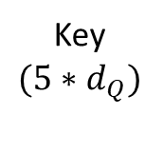
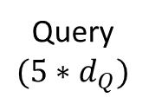
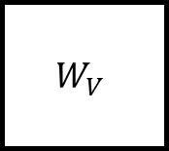
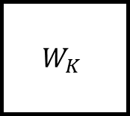
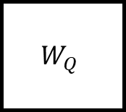
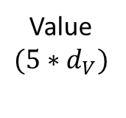
Key, Query, Value retrieval
$$W_{Q}$$
Q
Query
$$(5∗d_{Q})$$
Hello
my
$$W_{K}$$
K
name
Key
$$(5∗d_{Q})$$
is
Jimin
$$W_{V}$$
V
Value
$$(5∗d_{V})$$
Trainable matrices
Notes:
In this course, we will be using PyTorch as our main deep learning framework

Slide 30
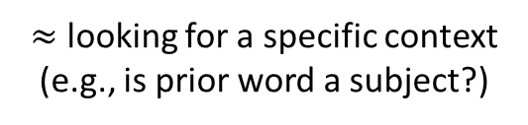
Key, Query, Value retrieval
$$W_{Q}$$
Q
Query
$$(5∗d_{Q})$$
$≈$ looking for a specific context
(e.g., is prior word a subject?)
Hello
my
$$W_{K}$$
K
name
Key
$$(5∗d_{Q})$$
is
Jimin
$$W_{V}$$
V
Value
$$(5∗d_{V})$$
Trainable matrices
Notes:
In this course, we will be using PyTorch as our main deep learning framework

Slide 31
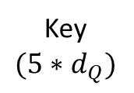
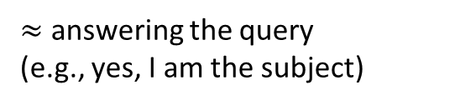
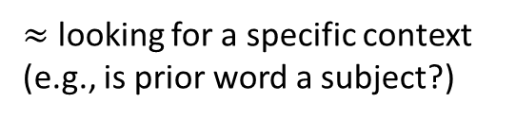
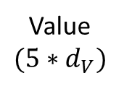
Key, Query, Value retrieval
$$W_{Q}$$
Q
Query
$$(5∗d_{Q})$$
$≈$ looking for a specific context
(e.g., is prior word a subject?)
Hello
my
$$W_{K}$$
K
name
Key
$$(5∗d_{Q})$$
$≈$ answering the query
(e.g., yes, I am the subject)
is
Jimin
$$W_{V}$$
V
Value
$$(5∗d_{V})$$
Trainable matrices
Notes:
In this course, we will be using PyTorch as our main deep learning framework

Slide 32

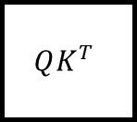
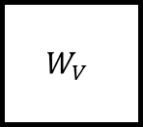
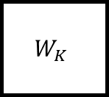
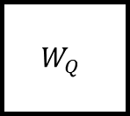

Key, Query, Value retrieval
Query
Hello
my
name
$$W_{Q}$$
Q
is
Jimin
Hello
Hello
my
my
$$W_{K}$$
K
$$QK^{T}$$
name
Key
name
is
is
Jimin
$$W_{V}$$
V
Jimin
Query
$≈$ is prior word a subject?
Key
$≈$ yes, I am the subject
Notes:
In this course, we will be using PyTorch as our main deep learning framework

Slide 33

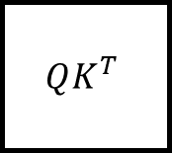
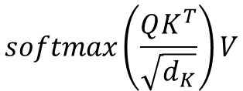
Key, Query, Value retrieval
$$W_{Q}$$
Q
Hello
my
$$W_{K}$$
K
$$QK^{T}$$
name
Softmax
is
Jimin
$$W_{V}$$
V
$$A$$
Probabilities
$$softmax\left(\frac{QK^{T}}{\sqrt{d_{K}}}\right)V$$
Notes:
In this course, we will be using PyTorch as our main deep learning framework

Slide 34
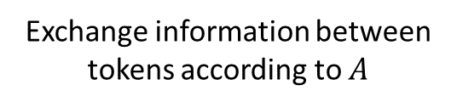
Key, Query, Value retrieval
$$W_{Q}$$
Q
Hello
my
$$W_{K}$$
K
$$QK^{T}$$
name
Softmax
is
Jimin
$$W_{V}$$
V
$$A$$
Probabilities
Exchange information between tokens according to $A$
Notes:
In this course, we will be using PyTorch as our main deep learning framework

Slide 35


Multi-headed attention
Q
K
V
Hello
$$⊕$$
my
Q
K
V
Linear transform
name
is
Jimin
$$⊕$$
Q
K
V
.
.
.
Notes:
In this course, we will be using PyTorch as our main deep learning framework

Slide 36
Transformer Architecture Encoder Decoder Transformer vs RNN

Slide 37
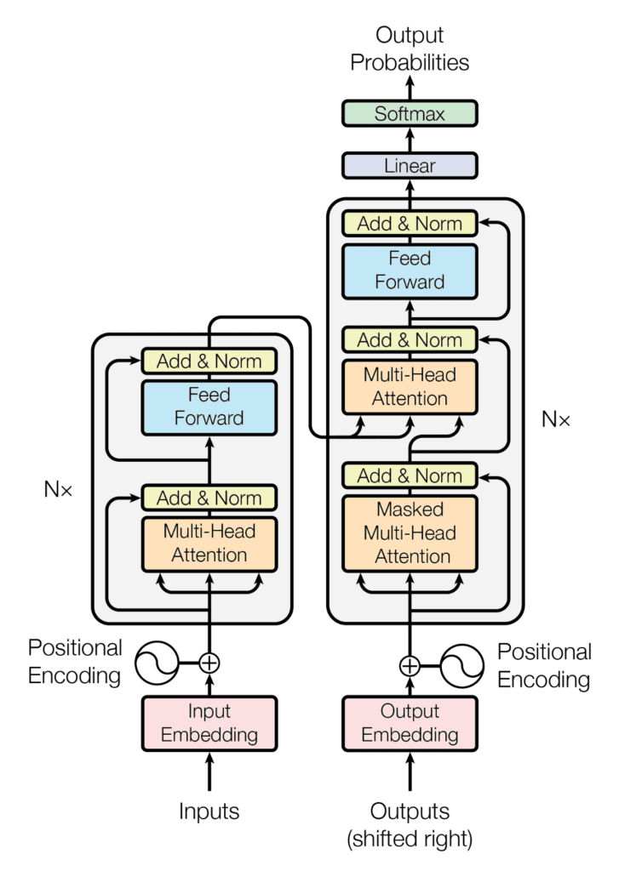
Transformer Architecture
Notes:
In this course, we will be using PyTorch as our main deep learning framework

Slide 38
Encoder
Encoder layer with
Input embedding with positional encoding
multi-headed self attention
Residual connections, Layer norm & dropout
Notes:
In this course, we will be using PyTorch as our main deep learning framework

Slide 39
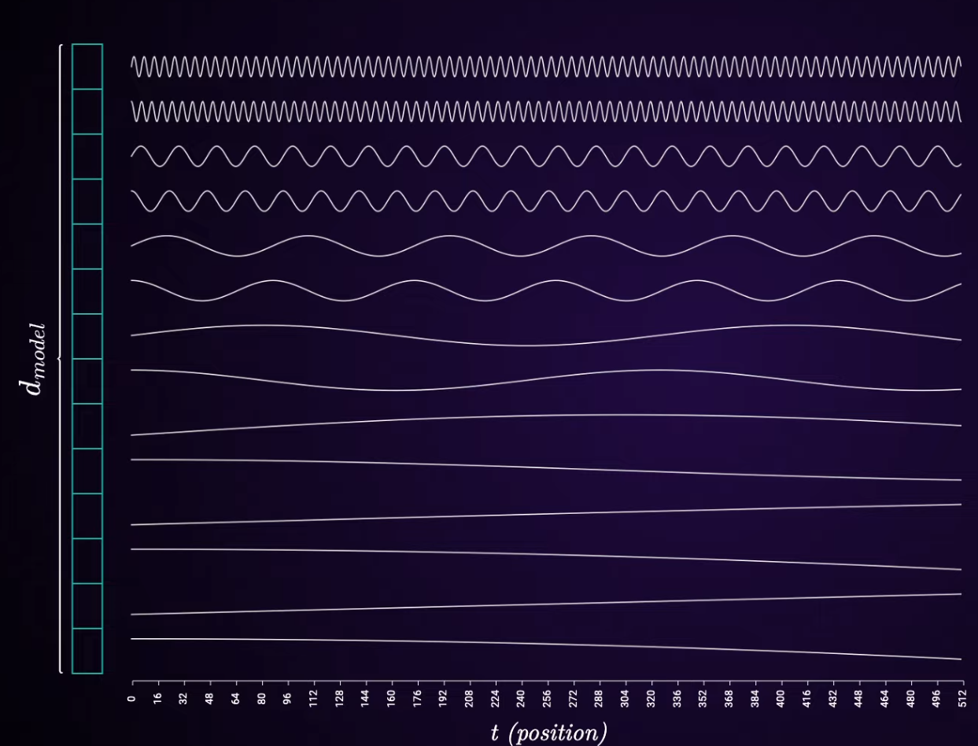
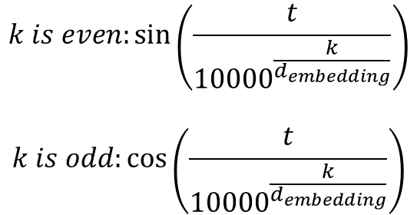
Positional Encoding
Hello
my
name
is
Jimin
$$k is even:\sin\left(\frac{t}{{10000}^{\frac{k}{d_{embedding}}}}\right)$$
$$k is odd:\cos\left(\frac{t}{{10000}^{\frac{k}{d_{embedding}}}}\right)$$
Notes:
In this course, we will be using PyTorch as our main deep learning framework

Slide 40
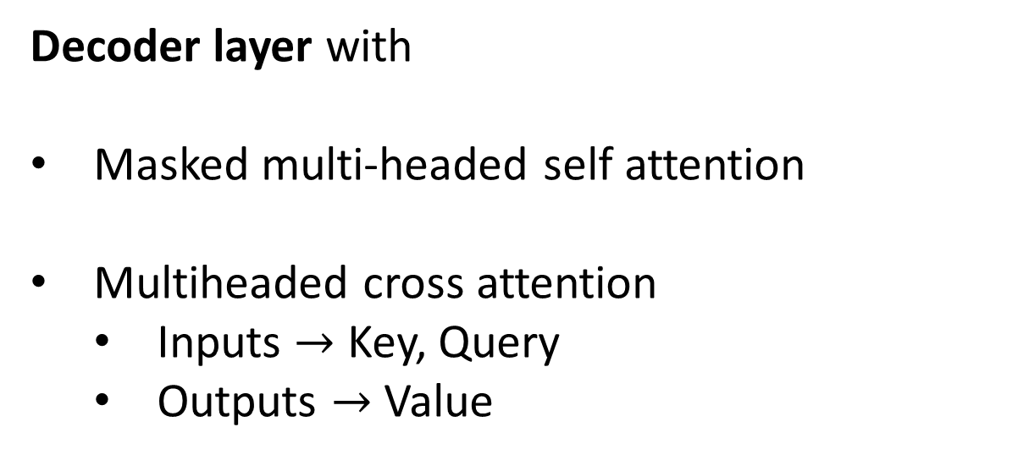
Decoder
Decoder layer with
Masked multi-headed self attention
Multiheaded cross attention
Inputs $→$ Key, Query
Outputs $→$ Value
Notes:
In this course, we will be using PyTorch as our main deep learning framework

Slide 41
Transformer vs RNN
Transformers
RNNs
Sequential
Parallel computation
Long-term dependencies
Scalability
Fine tuning
No
Yes
Yes
Yes
Yes
Yes
No
Kind of
Problematic
Difficult
Notes:
In this course, we will be using PyTorch as our main deep learning framework

Slide 42
Transformer Applications NLP Computer Vision Multi-modal Audio and Speech Signal processing

Slide 43
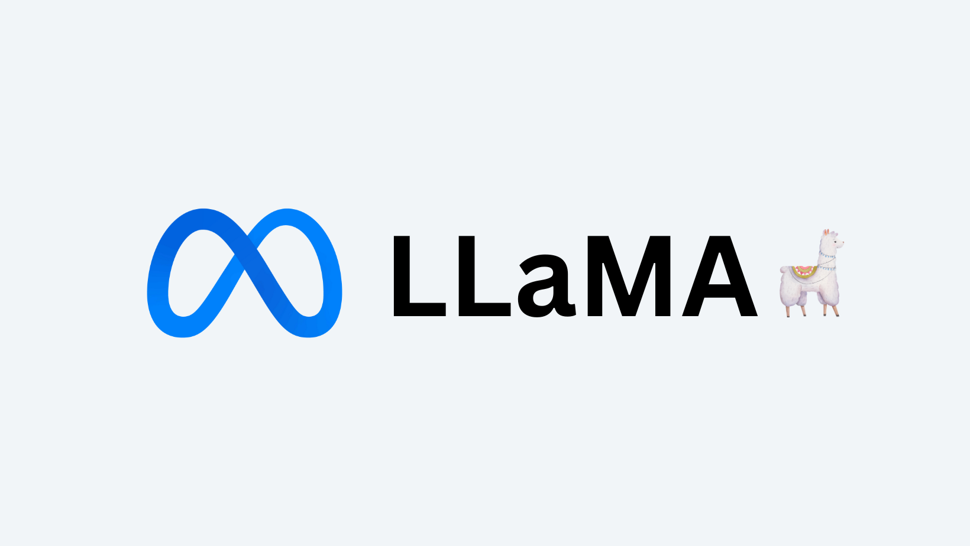

NLP
Notes:
In this course, we will be using PyTorch as our main deep learning framework

Slide 44
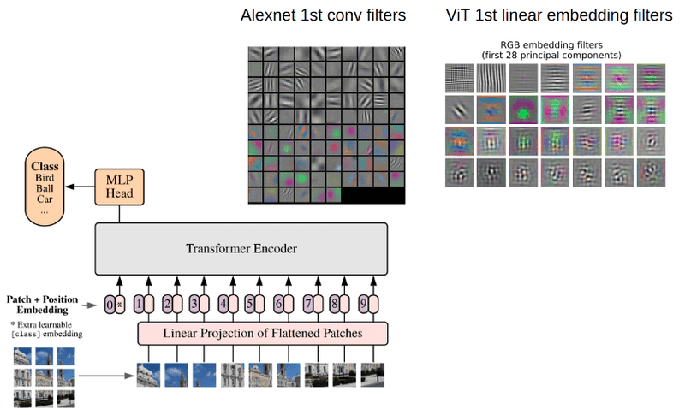
Computer Vision
Notes:
In this course, we will be using PyTorch as our main deep learning framework

Slide 45
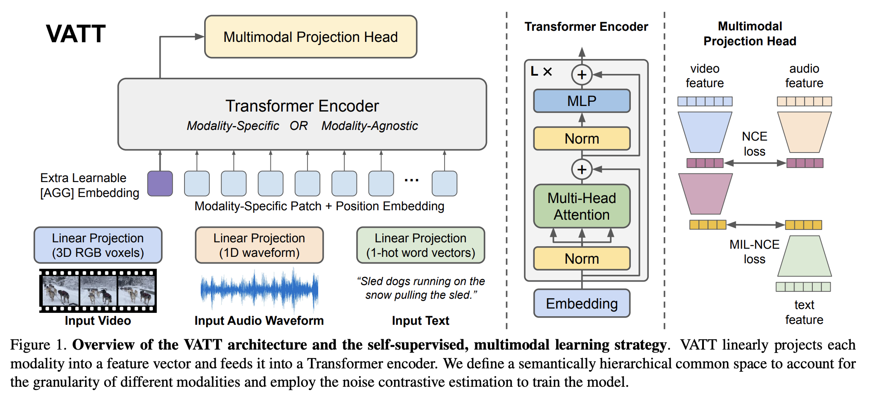
Multi-modal
Notes:
In this course, we will be using PyTorch as our main deep learning framework

Slide 46
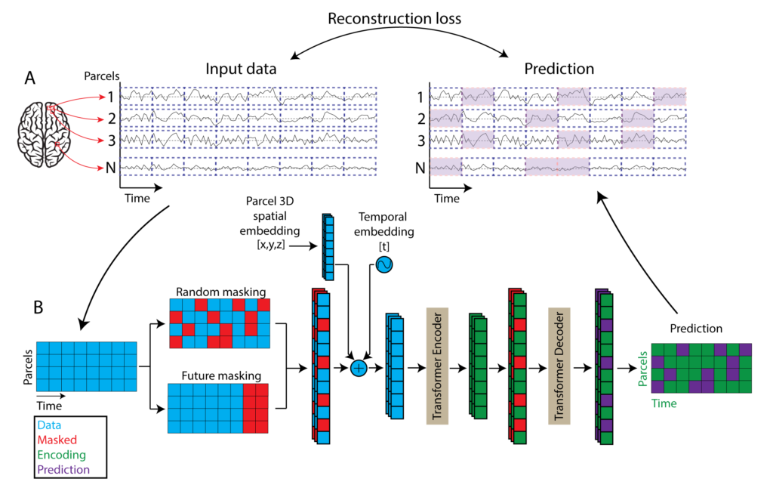
Signal processing
Notes:
In this course, we will be using PyTorch as our main deep learning framework

Slide 47
Next episode in EEP 596…

